Slide 1
Social World Connectivity among Indian Celebrities
Made and Presented By : Harshit Bhatt

Slide 2
Technologies Used
MySQL Database
Twitter API
Gephi
igraph
Python Language

Slide 3

What are we Achieving ?
Collecting tweets, retweets mentioning Indian Celebrities.
Movie Stars
Sport Stars
Politicians
Collecting “hashtags” and “user mentions” entities of tweet data with information on tweets and user information.
Notes:
The main objective of the network was to form a relationship among the Indian celebrities .

Slide 4
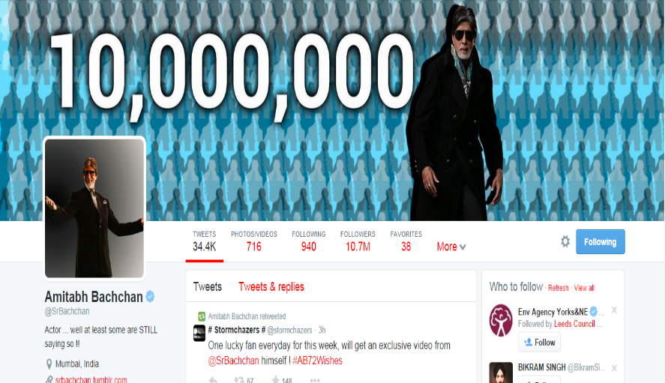
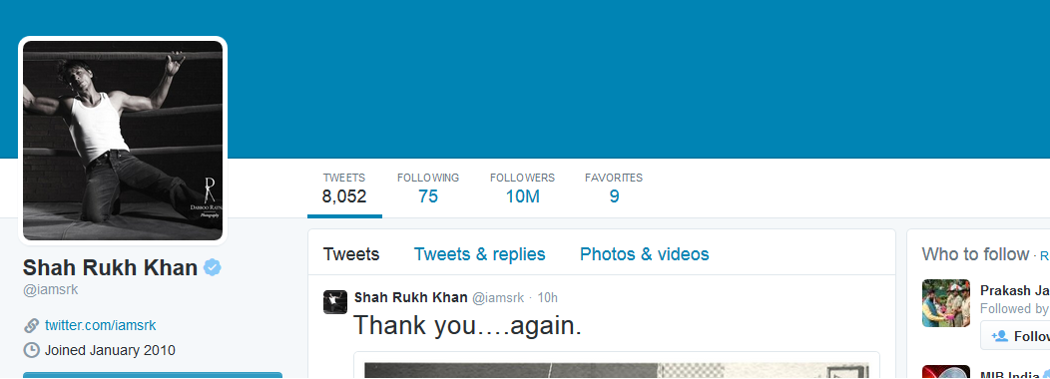
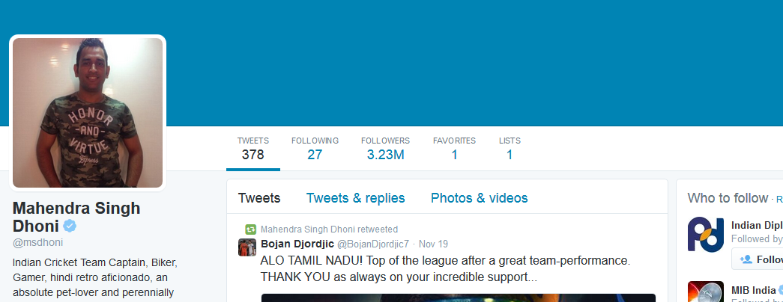
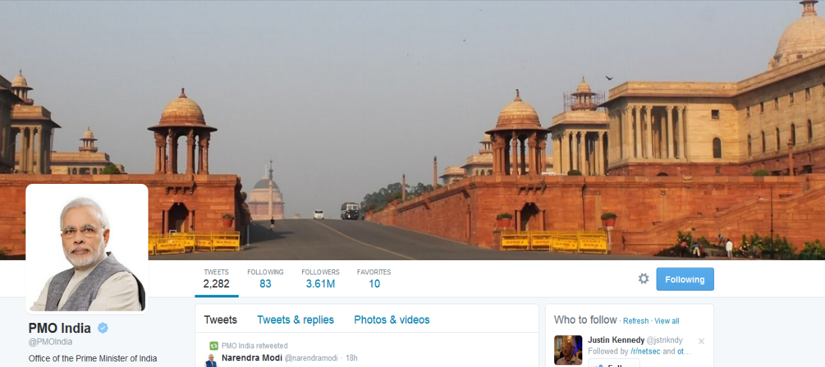
Chose four of these famous Indian Celebrities @SrBachchan, @iamsrk, @msdhoni, @pmoindia initially.
Collected there ‘friends’ and ‘friends of friends’ in the DB of whom mentions were the tweets collected. (467 distinct celebrities)

Slide 5

Only collected the verified accounts users for sake of data limitation.

Slide 6
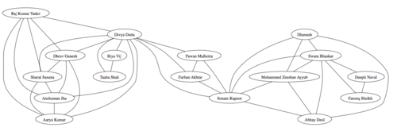
A prototype collection of what I wish to achieve.
Three networks were drawn concerning Celebrities relationship in terms of common users, common mentions and common hashtags.
Notes:
Main table from which six tables were constructed through which 3 networks were made.

Slide 7
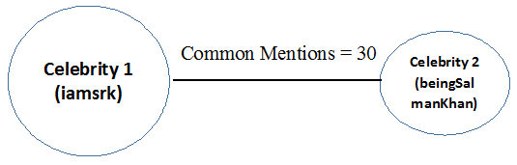
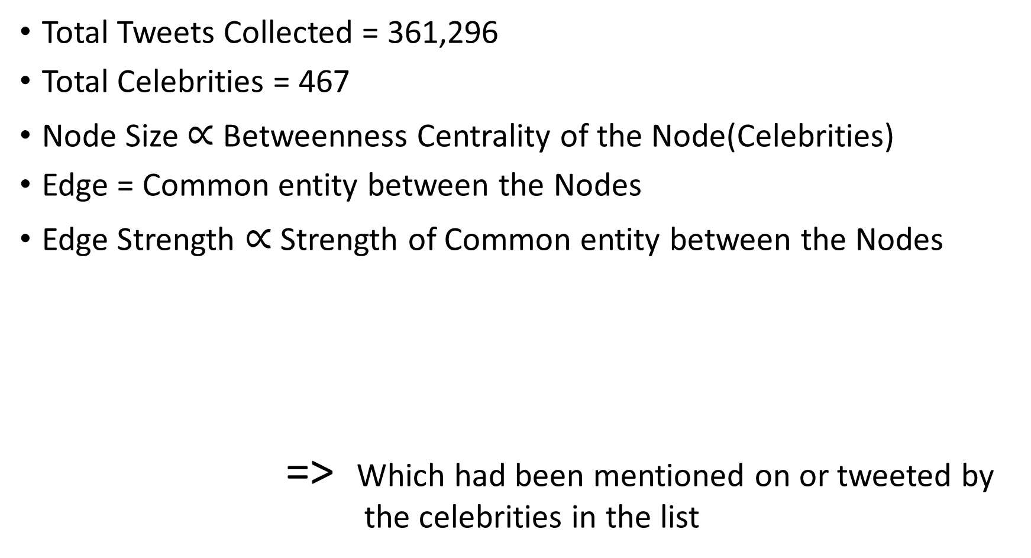
Facts for the Network
Total Tweets Collected = 361,296
Total Celebrities = 467
Node Size $∝$ Betweenness Centrality of the Node(Celebrities)
Edge = Common entity between the Nodes
Edge Strength $∝$ Strength of Common entity between the Nodes
=> Which had been mentioned on or tweeted by the celebrities in the list
Tweets Collected

Slide 8
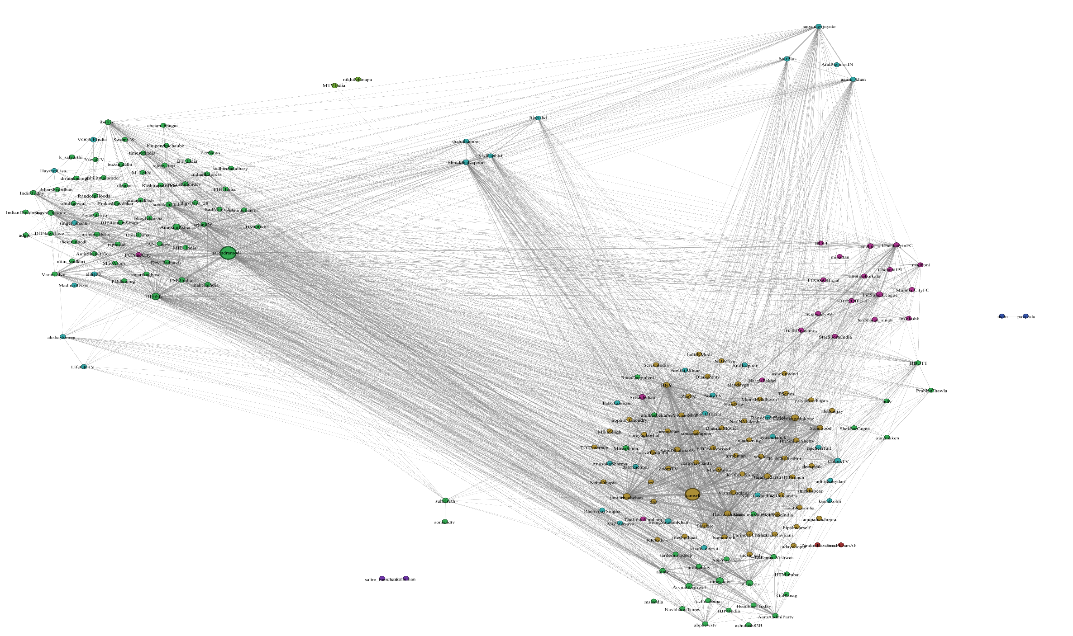
Common Users details :
Notes:
For all the networks I used Open Ord layout and modularity class to distinguish between the communities

Slide 9
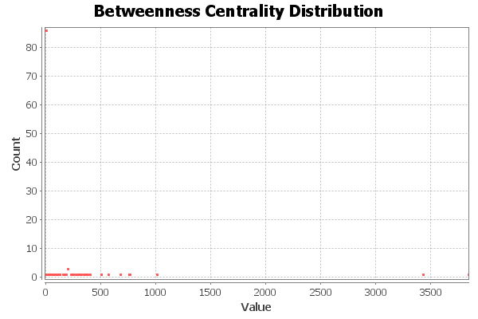
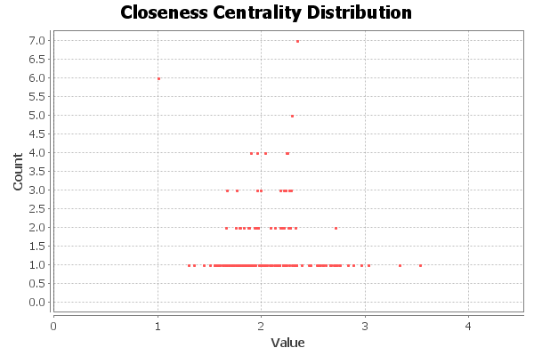
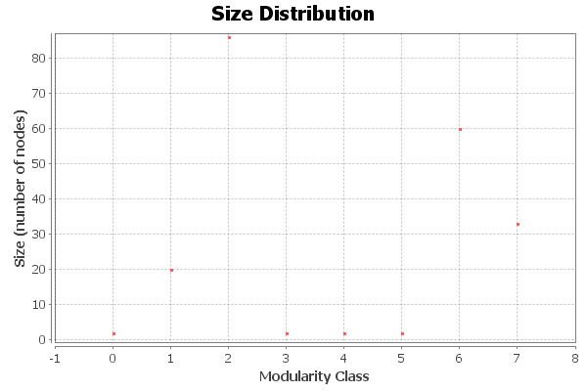
Notes:
Diameter = 5, Radius: 1, Average Path length: 2.0907327264587376, Number of shortest paths: 40206
Modularity: 0.351, Number of Communities: 8

Slide 10
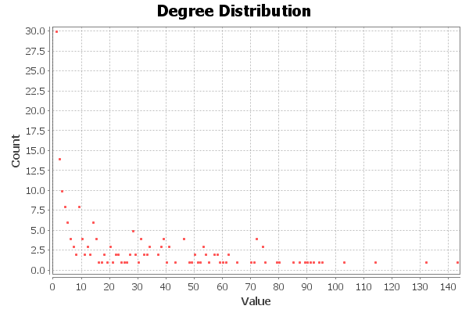
Notes:
Average Degree: 26.947

Slide 11
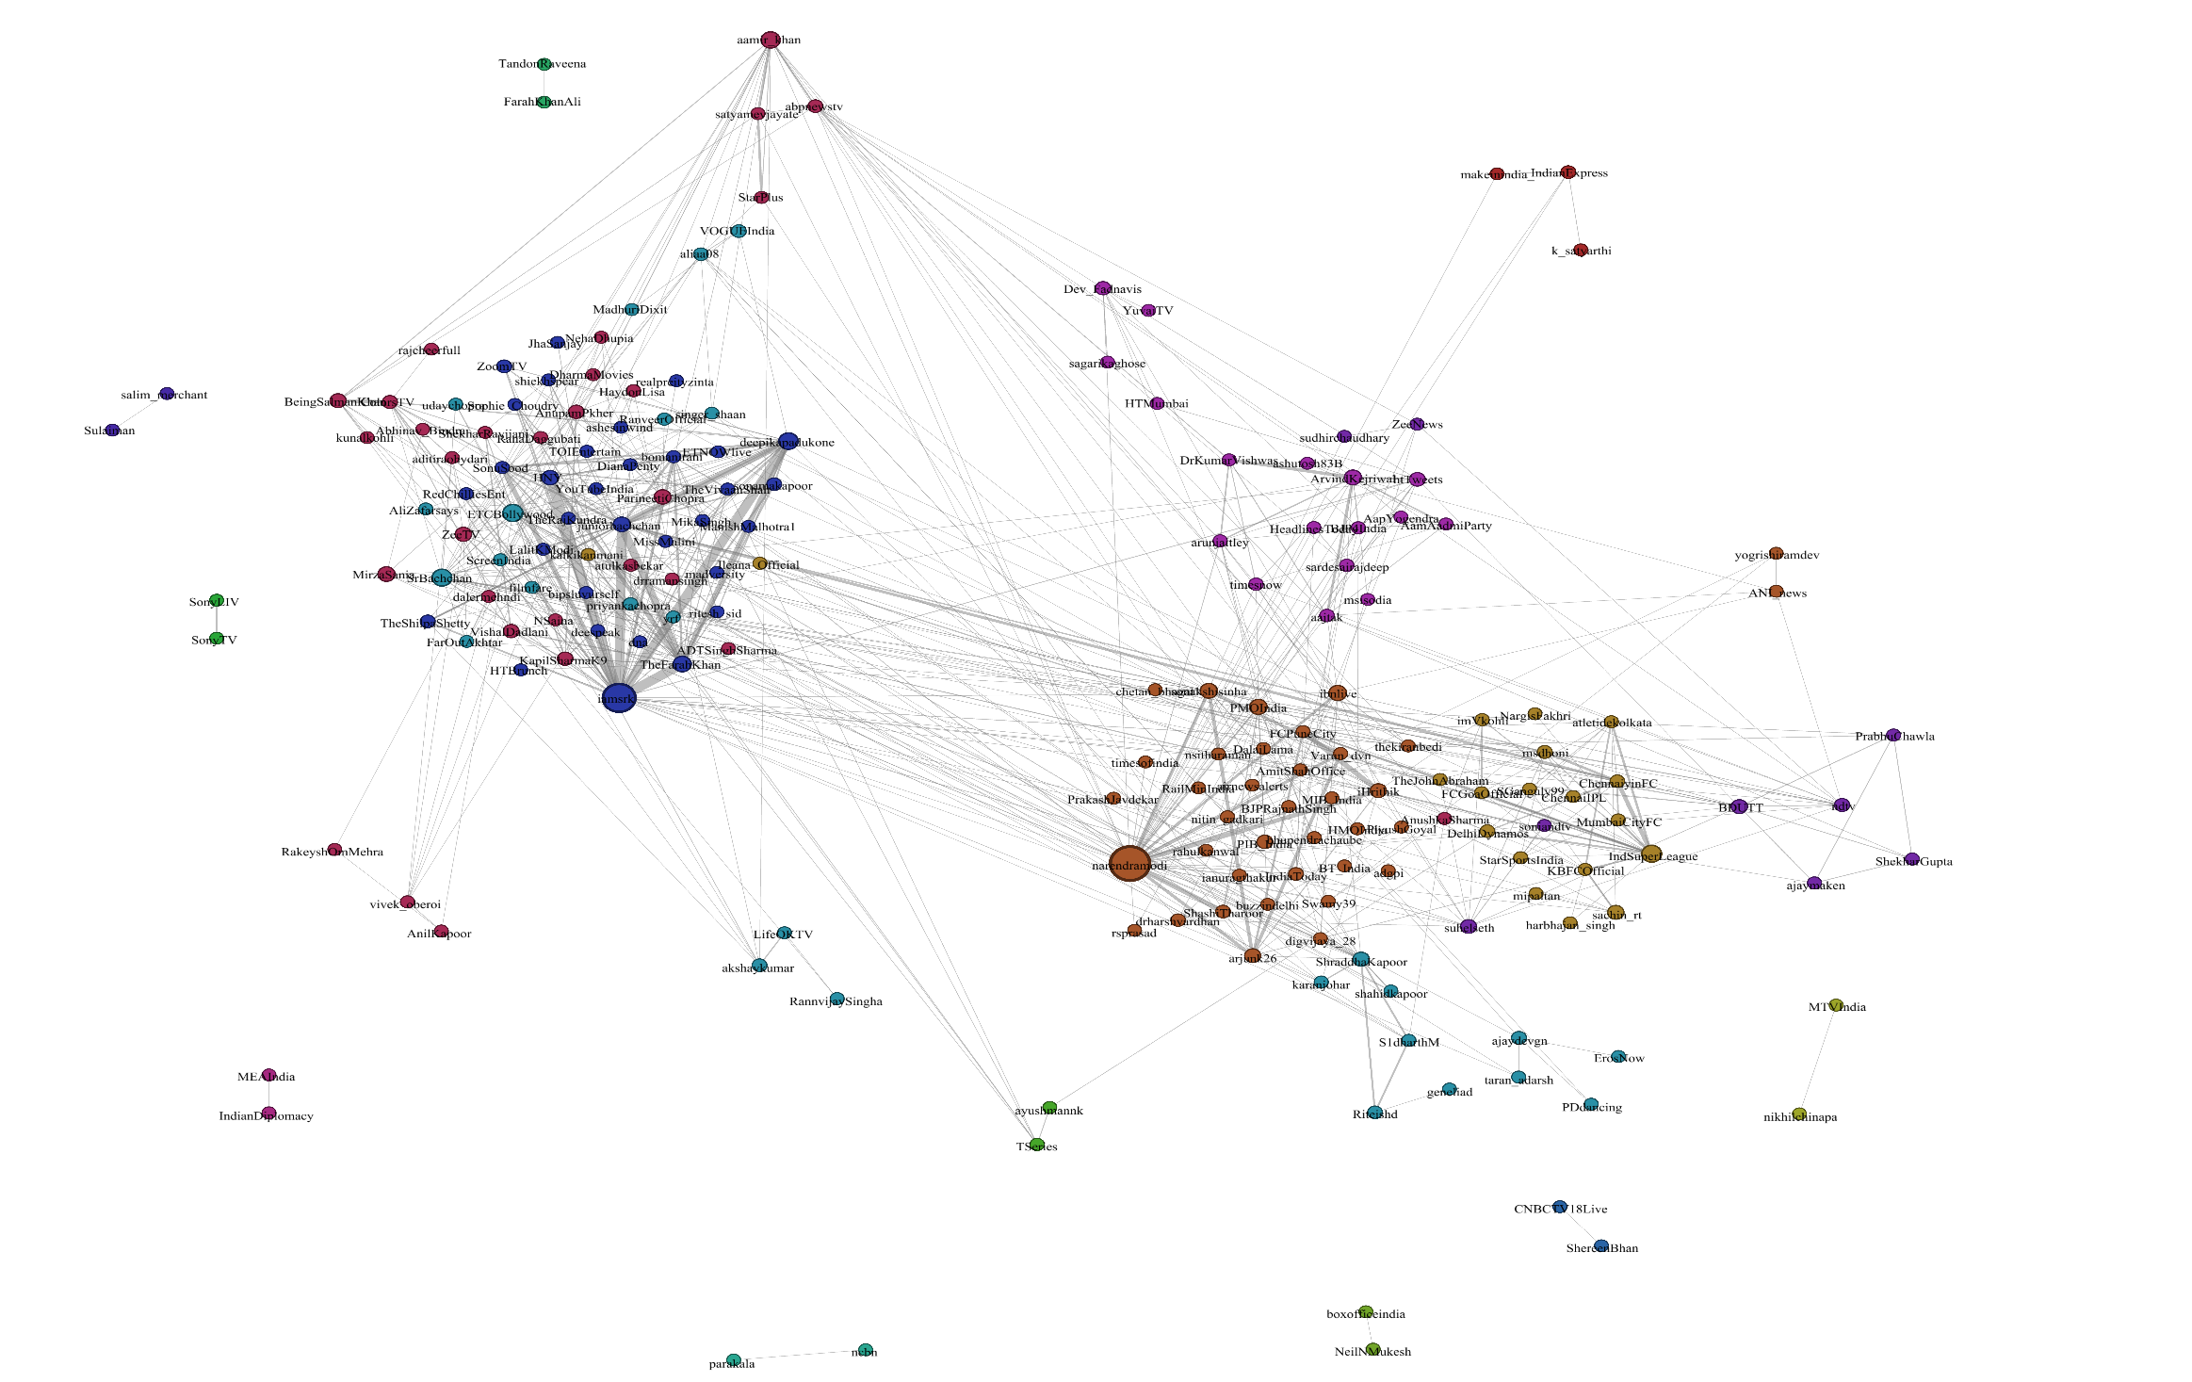
Common Mention details :
Notes:
This network differs from the first on the basis that it has many communities. Applied gephi filters so not every node is present.

Slide 12
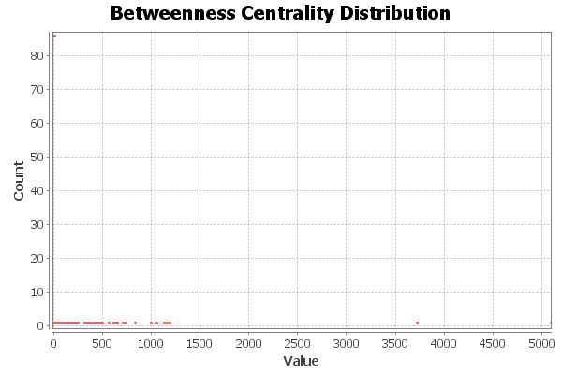
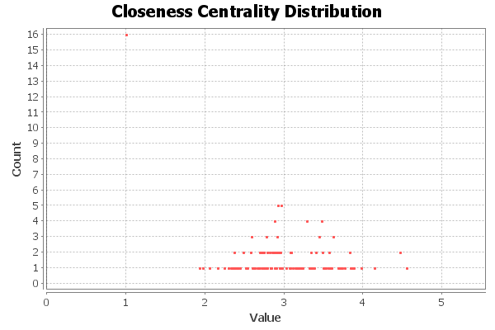
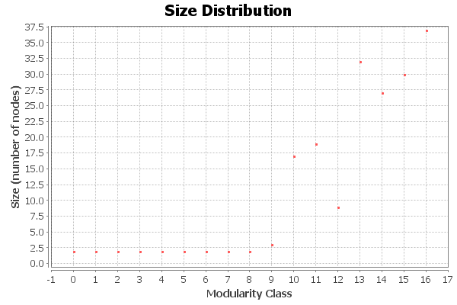
Notes:
Diameter: 6, Radius: 1, Average Path length: 3.019535306334372
Modularity: 0.580, Number of Communities: 17

Slide 13
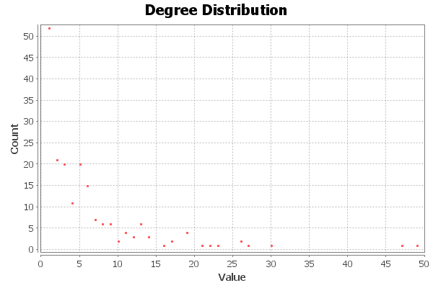
Notes:
Average Degree: 6.021

Slide 14
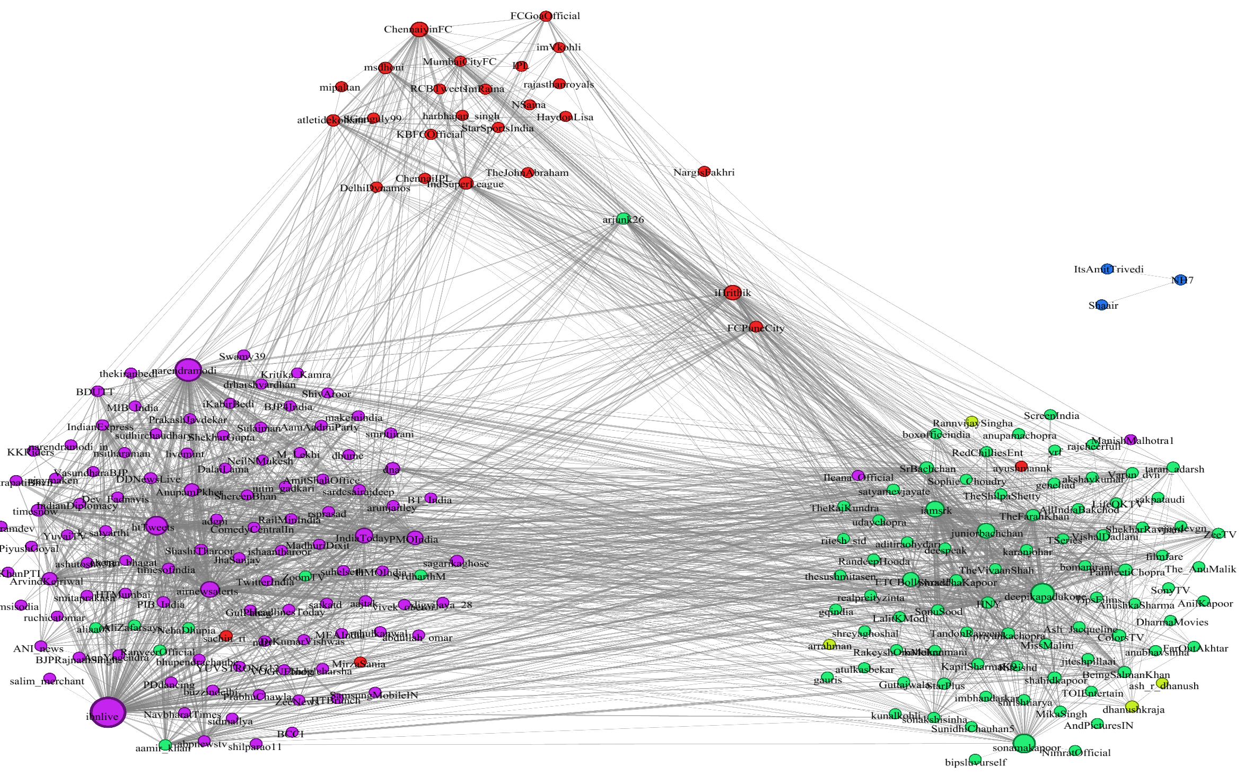
Hashtags Common details :

Slide 15
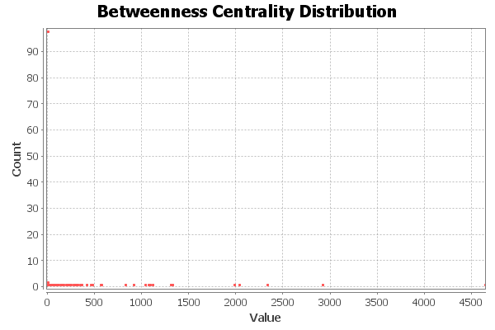
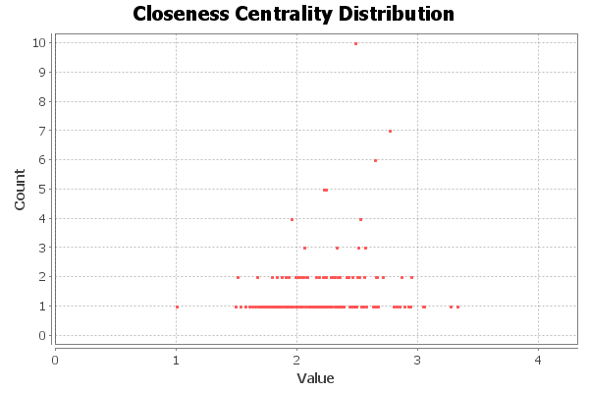
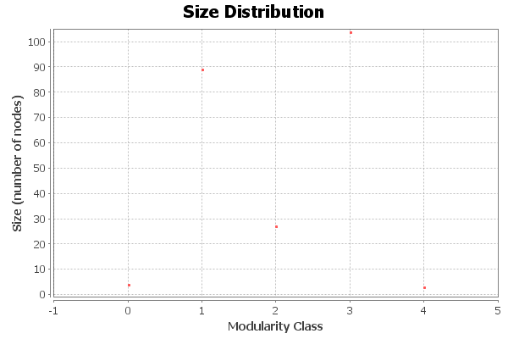
Notes:
Diameter: 5, Radius: 1, Average Path length: 2.272388806597542
Modularity: 0.315, Number of Communities: 5

Slide 16
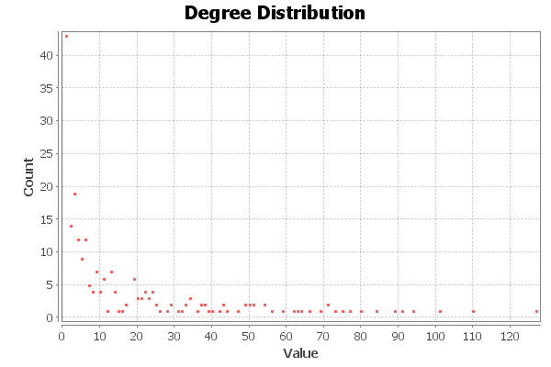
Notes:
Average Degree: 18.106

Slide 17
Conclusion
After studying all three networks, Indian Prime Minister @narendramodi, Movie Star @iamsrk came out as the most popular Indian celebrities in term of their involvement with users and other celebrities.
There were three major communities that were formed in all three networks constituting of movie stars, politicians and @IndSuperLeague event which constitutes most of the sport stars.
This explains that the tweeting community is also divided into certain groups.
There were also some exceptions as there was mix of celebrities from different fields in some clusters.
Notes:
Speak At last : But these relationships are due to certain events which were happening in the country.

Slide 18
Areas to improve
I would like to extend this study with inclusion of sentiment analysis for tweets which would explain what users are tweeting about the celebrities.
I could have also constructed two bipartite networks one between celebrities – users and other between celebrities – hashtags which would have gave me more information on this network as it would have deduced who are the dedicated users for celebrities, and would have also explained that celebrities are connected with which hashtags the most.

Slide 19
Related Work
Movies and Actors : Mapping the Internet Movie Database - Bruce W. Herr, Katy Borner, Weimao Ke, Elisha Hardy. 2007
Measurement and Analysis of Online Social Networks - Alan Mislove, Peter Druschel, Massimiliano Marcon, Krishna P. Gummadi, Bobby Bhattacharjee. 2007
Fafadia Tech Blog. 2014

